Slide 1

A Supervised Machine Learning Approach to Predicting Risk Factors in Youth Drug Use Machine Learning II
By Erdenetuya Namsrai
2025

Slide 2
Contents
Introduction
Theoretical Background
Methodology
Results
Discussion
Conclusion
Bibliography/References

Slide 3
Introduction
Dataset: National Survey on Drug Use and Health (NSDUH)
/Youth Data, 2023
Goal: To investigate factors that are correlated with youth drug use
Models used: Tree Based Machine Learning Methods
- Decision Trees
- Bagging
- Random Forest
Tasks:
- Binary classification
- Multi class classification)
- Regression

Slide 4
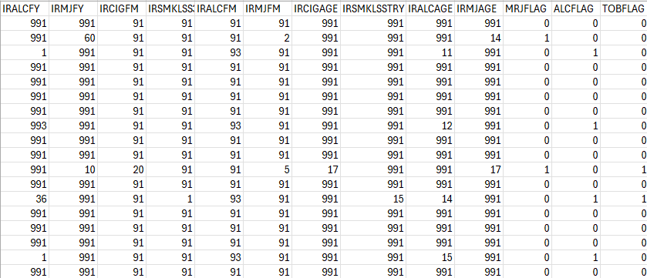
YouthR Dataset 2023
Variables:
Substance Use
Tobacco
Alcohol
Marijuana
Mental Health
Major depressive episodes (MDE)
Suicidal thoughts and behaviors
Perceived mental health treatment needs
Demographics
Age, sex, race/ethnicity
Education, income, employment
Geography (e.g., region, urban/rural status)
Youth Experience Variables
Per influence
School performance
Parental monitoring
Risk perception
Source: NSDUH 2023 Public-Use Data, SAMHSA
Population: USA
Age: 12 years and older
10,561 observations
79 variables

Slide 5
Theoretical Background
Tree-based machine learning methods are used to study the factors influencing youth drug use, offering models that are easy to interpret
1. Decision Tree
A decision tree classifies data by recursively splitting it into binary partitions based on feature values
Measures:
- Gini Index
- Entropy
- Classification Error
Performance:
- Classification Accuracy
- Mean Squared Error
Trees can be made simpler by pruning, which helps prevent overfitting and improves accuracy on new data

Slide 6
Theoretical Background
2. Bagging
Creates many trees using random samples and combines their results to make better predictions
Measures:
- Out-of-Bag (OOB) Error
- Variable Importance
Performance:
- Classification Accuracy
- Mean Squared Error
3. Random Forest
Similar to bagging, but at each tree split, only a random subset of features is considered instead of all features.
Measures:
- Out-of-Bag (OOB) Error
- Variable Importance
Performance:
- Classification Accuracy
- Mean Squared Error

Slide 7
Methodology
Data Cleaning Process
- Removed NA values from dataset: 8249 observations, 79 variables
Dataset:
- Training 70%
- Testing 30%
- Out-of-Bag (OOB) Error
- Variable Importance
Models:
- Decision Tree
- Pruned Decision Tree
- Bagging
- Random Forest
Model Evaluation:
Binary and multi class Classification: Accuracy, Test Error and Out of Bag Error
Regression: Mean Squared Error, Root Mean Squared Error

Slide 8
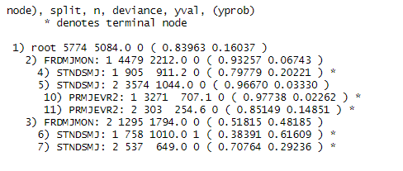
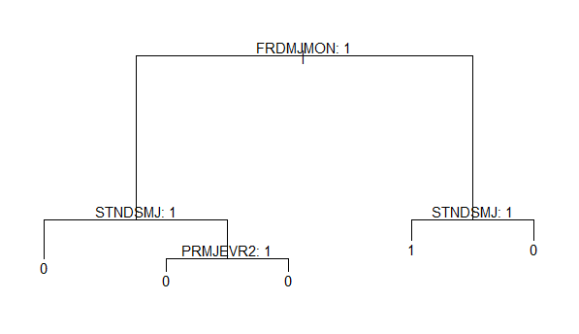
Results/Binary Classification/Pruned Tree/MRJFLAG
The first split is based on
FRDMJMON (friends who use marijuana), split value 0.93
- STNDSMJ (Perceived standards around marijuana use), purity 0.96
- PRMJEVR2 (Parents ever used marijuana), 0.97
Terminal nodes show the class probabilities
- PRMJEVR2 (Parents ever used marijuana), 0.97 predicted marijuana use

Slide 9
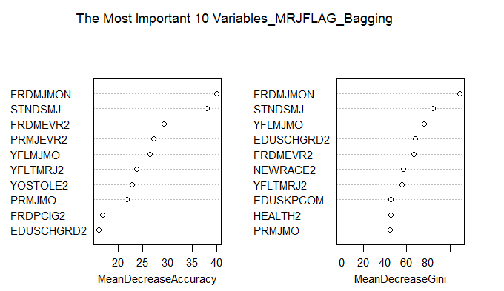
Results/Binary Classification/Bagging/MRJFLAG
Accuracy: Higher values mean the variable is more important for accurate predictions:
FRDMJMON (Number of friends who use marijuana monthly)
STNDSMJ (Standardized Measure of Marijuana Use)
FRDMEVR2 (How many of your close friends have ever used marijuana)
Gini: Higher values mean more contribution to model purity:
- FRDMJMON (Number of friends who use marijuana monthly)
- STNDSMJ (Standardized Measure of Marijuana Use)
- YFLMJMO (used marijuana in the past 30 days)

Slide 10
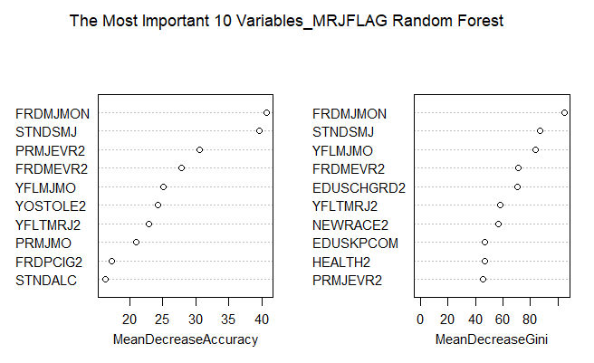
Results/Binary Classification/Random Forest/ MRJFLAG
Accuracy: The higher the score, the more important the variable is to accurate predictions
FRDMJMON (Number of friends who
use marijuana monthly)
STNDSMJ (perceived standards around
marijuana)
PRMJEVR2 (Parent(s) ever used marijuana)
Gini: A higher score means the variable frequently helps distinguish marijuana users.
FRDMJMON (Number of friends who
use marijuana monthly)
STNDSMJ (Perceived standards of friends regarding marijuana use)
YFLMJMO (Used marijuana in the past month)

Slide 11
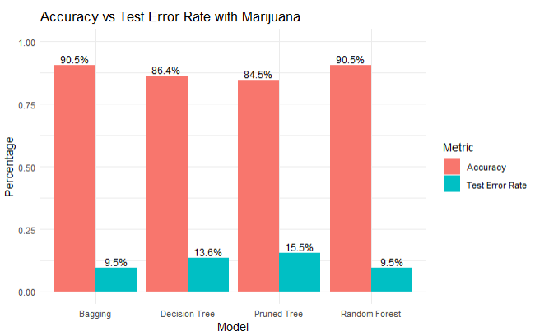
Results/Binary Classification/Marijuana Use Prediction
Graph 1. Model Evaluation with Marijuana

Slide 12
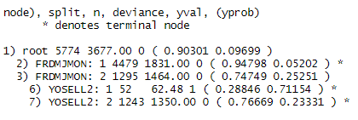
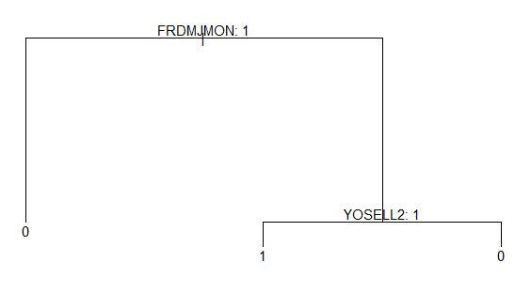
Results/Binary Classification/Pruned Tree/TOBFLAG
The first split is based on
FRDMJMON (Number of friends who use marijuana monthly), split value: 0.94
Terminal nodes show the class probabilities
- YOSELL2 (ever sold illegal drugs), probability: 0.76

Slide 13
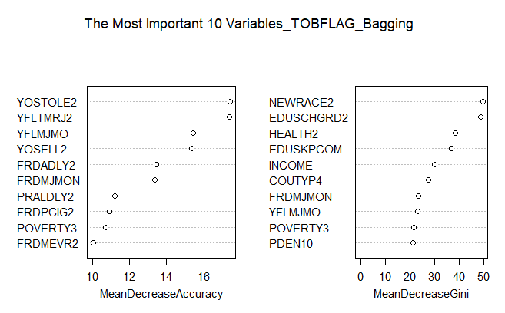
Results/Binary Classification/Bagging/TOBFLAG
Accuracy: The higher the score, the more important the variable is to accurate predictions
YOSTOLE2 (ever stolen anything worth more than $50)
YFLTMRJ2 (ever used marijuana or hashish) YFLMJMO (used marijuana in the past 30 days)
Gini: A higher score means the variable frequently helps distinguish tobacco users.
NEWRACE2 (race)
EDUSCHGRD2 (what grade in now/will be in)
HEALTH2 (overall health)

Slide 14
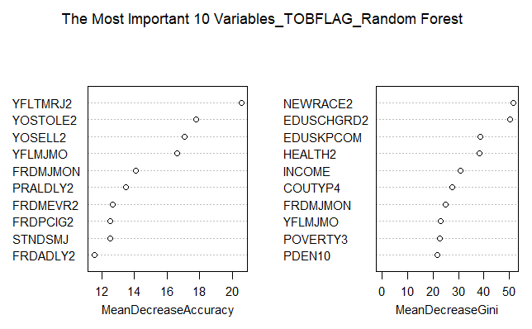
Results/Binary Classification/RandomForest/TOBFLAG
Accuracy: The higher the score, the more important the variable is to accurate predictions
YFLTMRJ2 (ever used marijuana or hashish) YOSTOLE2 (ever stolen anything worth more than $50)
YOSELL2 (ever sold illegal drugs)
Gini: A higher score means the variable frequently helps distinguish tobacco users.
NEWRACE2 (race)
EDUSCHGRD2 (what grade in now/will be in)
EDUSKPCOM (how many days skipped school in past month)

Slide 15
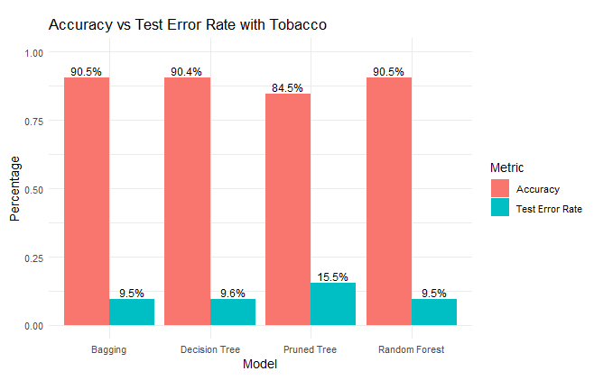
Results/Binary Classification/Tobacco use Prediction
Graph 2. Model Evaluation with Tobacco

Slide 16
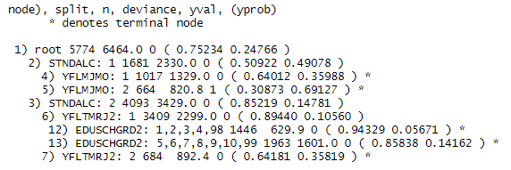
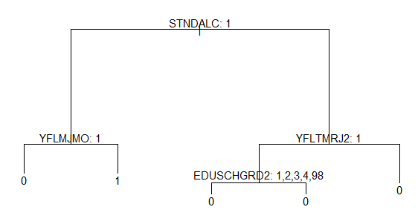
Results/Binary Classification/Pruned Tree/ALCFLAG
The first split is based on
STNDALC (friends who use marijuana), 0.94
Terminal nodes show the class probabilities
- YFLMJMO (used marijuana in the past 30 days)
- EDUSCHGRD2 (what grade in now/will be in)

Slide 17
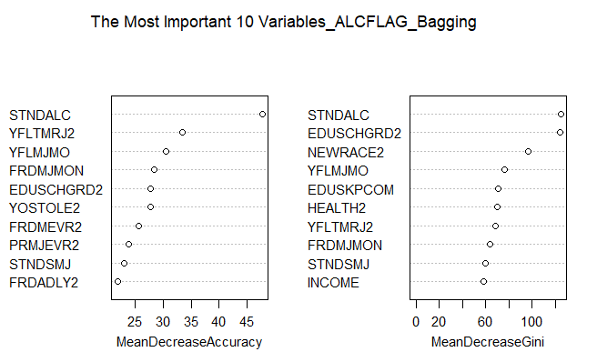
Results/Binary Classification/Bagging/ALCFLAG
Accuracy: The higher the score, the more important the variable is to accurate predictions
STNDALC (perceived standards of friends regarding alcohol use)
YFLTMRJ2 (ever used marijuana or hashish)
YFLMJMO (used marijuana in the past 30 days)
Gini: A higher score means the variable frequently helps distinguish alcohol users.
STNDALC (perceived standards of friends regarding alcohol use) EDUSCHGRD2 (what grade in now/will be in) NEWRACE2 (race)

Slide 18
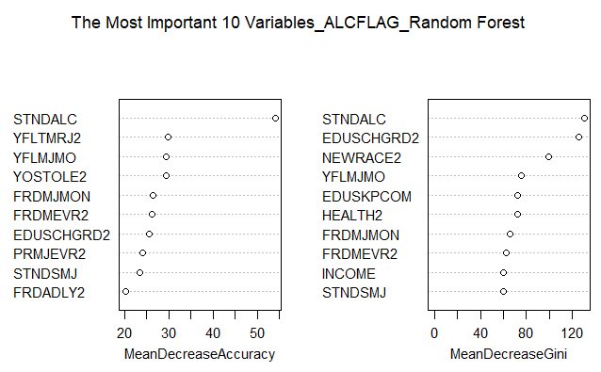
Results/Binary Classification/RandomForest/ALCFLAG
Accuracy: The higher the score, the more important the variable is to accurate predictions
STNDALC (perceived standards of friends regarding alcohol use)
YFLTMRJ2 (ever used marijuana or hashish)
YFLMJMO (used marijuana in the past 30 days)
Gini: A higher score means the variable frequently helps distinguish alcohol users.
STNDALC (perceived standards of friends regarding alcohol use)
EDUSCHGRD2 (what grade in now/will be in)
NEWRACE2 (race)

Slide 19
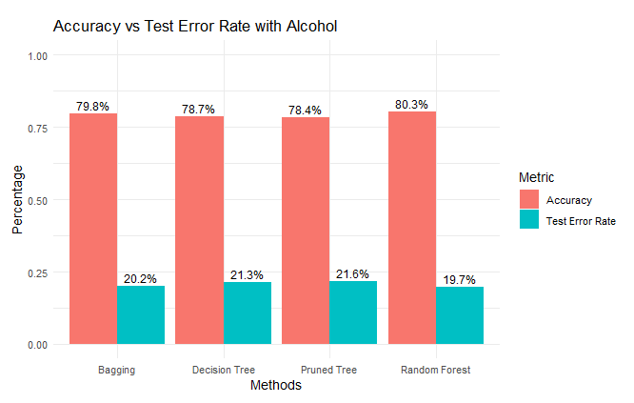
Results/Binary Classification/ Alcohol use Prediction
Graph 2. Model Evaluation with Alcohol

Slide 20
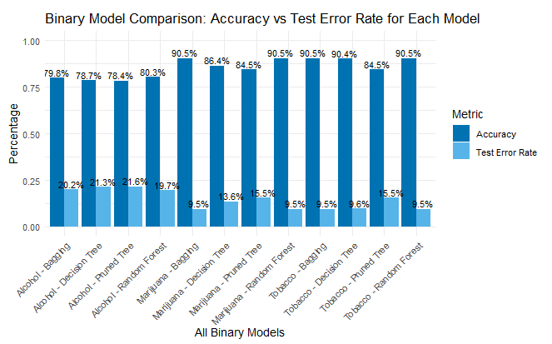
Results/Binary Classification Models Comparison
Graph 3. Model Evaluation with Alcohol, Marijuana, and Tobacco

Slide 21
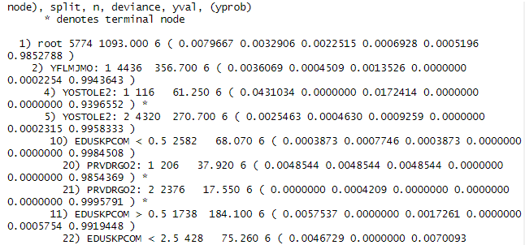
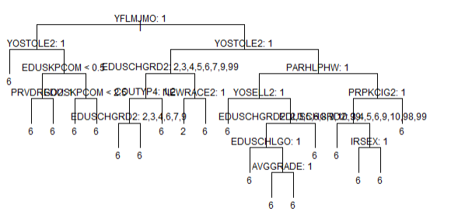
Results/ Multi class Classification/Decision Pruned Tree/ CIGMDAYS
The first split is based on
YFLMJMO (Used marijuana in the past month)
Terminal nodes show the class probabilities
- YFLMJMO (used marijuana in the past 30 days (past month)
- EDUSCHGRD2 (what grade in now/will be in)

Slide 22
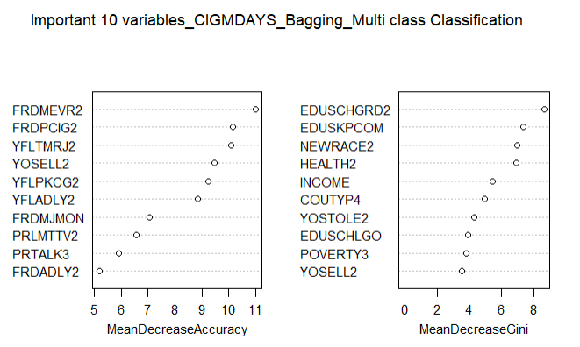
Results/ Multi class Classification/Bagging/CIGMDAYS
Accuracy: The higher the score, the more important the variable is to accurate predictions
FRDMEVR2 (Number of friends who ever used marijuana)
FRDPCIG2 (Number of friends who smoke cigarettes)
YFLTMRJ2 (Ever used marijuana or hashish)
Gini: A higher score means the variable frequently helps distinguish cigarette users.
EDUSCHGRD2 (what grade in now/will be in) EDUSKPCOM (how many days skipped school in past month)
NEWRACE2 (race)

Slide 23
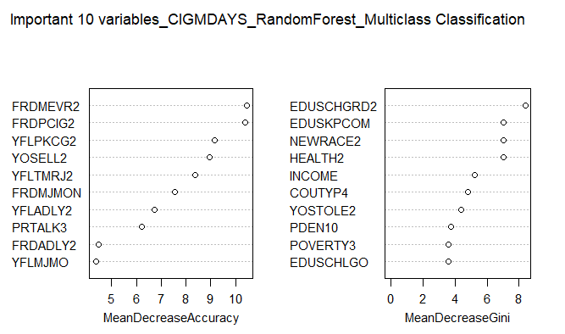
Results/ Multi class Classification/Random Forest/CIGMDAYS
Accuracy: The higher the score, the more important the variable is to accurate predictions
FRDMEVR2 (Number of friends who ever used marijuana)
FRDPCIG2 (Number of friends who smoke cigarettes)
YFLPKCG2 (Ever smoked part or all of a cigarette)
Gini: A higher score means the variable frequently helps distinguish cigarette users.
EDUSCHGRD2 (what grade in now/will be in)
EDUSKPCOM (how many days skipped school in past month)
NEWRACE2 (race)

Slide 24
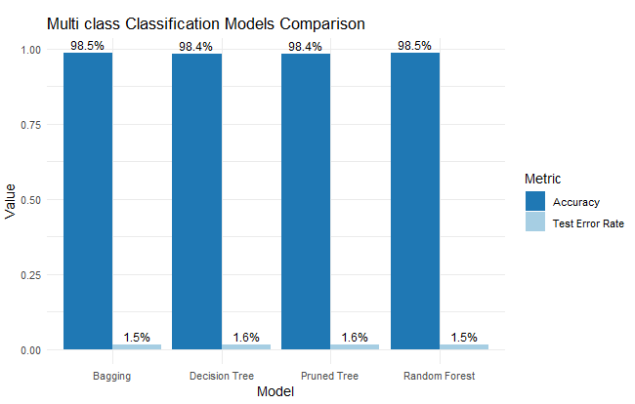
Results/ Multi class Classification Models/CIGMDAYS
Graph 4. Model Evaluation with Cigarette

Slide 25
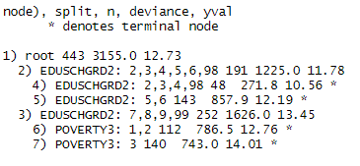
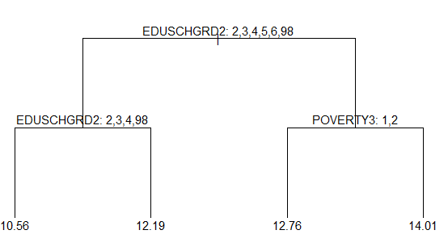
Results/ Regression/ Pruned Decision Tree/IRCIGAGE
The first split is based on
EDUSCHGRD2 (what grade in now/will be in)
Terminal nodes show the predicted values
- EDUSCHGRD2 (what grade in now/will be in), associated with predicted levels of tobacco use
- POVERTY (poverty level), further splits help refine predictions of tobacco use.

Slide 26
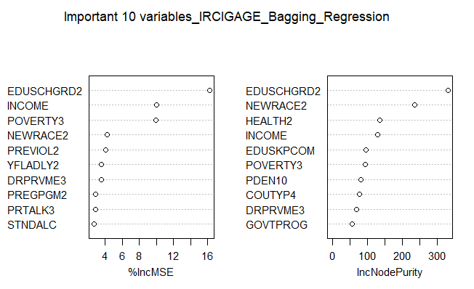
Results/ Regression/ Bagging/ IRCIGAGE
MSE: The higher the score, the more important the variable is to accurate predictions
EDUSCHGRD2 (what grade in now/will be in)
INCOME (total family income)
POVERTY3 (poverty level)
NodePurity: A higher value means the variable is more effective at splitting the data to separate tobacco users.
EDUSCHGRD2 (what grade in now/will be in)
NEWRACE2 (race)
HEALTH (overall health)

Slide 27
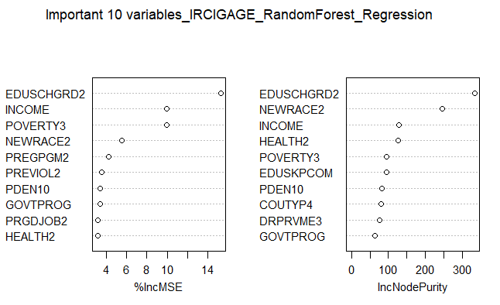
Results/ Regression/ Random Forest/ IRCIGAGE
MSE : The higher the score, the more important the variable is to accurate predictions
EDUSCHGRD2 (what grade in now/will be in)
INCOME (total family income)
POVERTY3 (poverty level)
NodePurity: A higher value means the variable is more effective at splitting the data to separate tobacco users
EDUSCHGRD2 (what grade in now/will be in)
NEWRACE2 (race)
HEALTH2 (overall health)

Slide 28
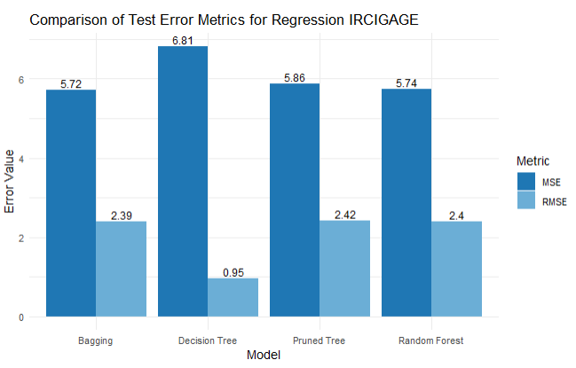
Results/ Regression/ Models/ IRCIGAGE
Graph 5. Model Evaluation with Cigarette Age of First Use

Slide 29
Discussion
This analysis used Decision trees, Bagging, and Random forest models to explore factors associated with drug use among youth, based on the YouthR 2023 dataset.
Random Forest and Bagging worked best - These models gave the highest accuracy and lowest error in almost every task.
What predicts drug use depends on the substance
- Marijuana: Peer influence was most important ( for example, friends using marijuana).
- Tobacco and Alcohol: Family income, grade level, and race mattered more.
Regression showed similar patterns
- Age of first cigarette use was lower in students with lower education and higher poverty.
Simple models are easier to understand
- Decision Trees were more interpretable.
- But ensemble models (Bagging and Random Forest) were more accurate.

Slide 30
Conclusion
Random Forest and Bagging gave the most accurate predictions for all tasks → binary, multiclass, and regression.
Best predictors varied by substance:
Marijuana → Peer influence
Tobacco & Alcohol → Socioeconomic and demographic factors (education, income, race)
Main understand : Early substance use is often linked to social environment, economic disadvantage, and behavioral history.

Slide 31
Bibliography/References
James, G., Hastie, T., Witten, D., & Tibshirani, R. (2023). An Introduction to Statistical Learning with Applications in R (2nd ed.). Springer.
Substance Abuse and Mental Health Services Administration (SAMHSA). (2023). National Survey on Drug Use and Health (NSDUH), 2023 Public-Use Data Files. https://www.samhsa.gov/data/dataset/national-survey-drug-use-and-health-2023-nsduh-2023-ds0001
Substance Abuse and Mental Health Services Administration (SAMHSA). (2023). NSDUH 2023 Codebook. https://www.samhsa.gov/data/system/files/media-puf-file/NSDUH-2023-DS0001-info-codebook_v1.pdf
Mendible, J. (2023). Youth Dataset for DATA 5322 [GitHub repository]. https://github.com/mendible/5322/blob/main/Homework%201/youth_data.Rdata
R Core Team. (2023). R: A Language and Environment for Statistical Computing. R Foundation for Statistical Computing, Vienna, Austria. https://www.R-project.org/

Slide 32
Thank You for Your Attention!

